Slide 1
CAB FARE PREDICTION USING MACHINE LEARNING
Project Guide : Dr. J. Jeslin Santhamalar
Name : L.Bharath sai
Register Number : 40110674
Notes:
CAB FARE PREDICTION USING MACHINE LEARNING

Slide 2
COURSE CERTIFICATE

Slide 3
INTRODUCTION
The project is about a cab company who has done its pilot project and now they are looking to predict the fare for their future transactional cases. As, nowadays there are number of cab companies like Uber, Ola, Meru Cabs etc. And these cab companies deliver services to lakhs of customers daily. Now it becomes really important to manage their data properly to come up with new business ideas to get best results. In this case, earn most revenues. So, it becomes really important estimate the fare prices accurately.

Slide 4
PROJECT OBJECTIVES
By the end of this project :
Know fundamental concepts and techniques used for machine learning.
Gain a broad understanding about data.
Have knowledge on pre-processing the data/capping techniques on outlier and some visualization concepts.
Gain some ideas on algorithm selection.

Slide 5
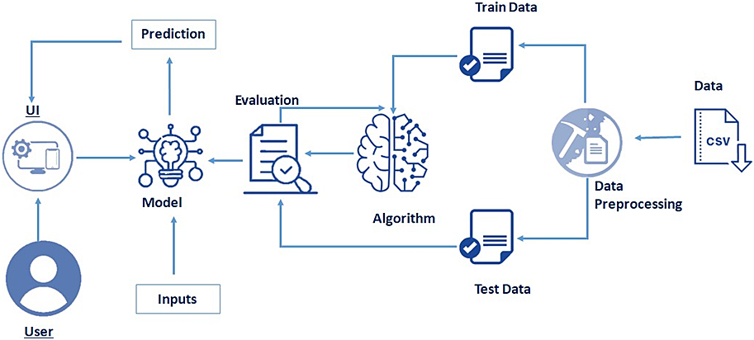
TECHNICAL ARCHITECTURE

Slide 6
PROJECT IMPLEMENTATION
Once model analyses the input the prediction is showcased on the UI To accomplish this, we have to complete all the activities listed below,
Data Collection.
Collect the dataset or Create the dataset
Data Visualization
Univariate analysis
Multivariate analysis
Descriptive analysis
Data Pre-processing
Checking for null values
Drop unwanted features
Data Cleaning and merging
Handling categorical data
Splitting Data into Train and Test.

Slide 7
Model Building
Import the model building Libraries
Initializing the model
Training and testing the model
Evaluation of Model
Save the Model

Slide 8
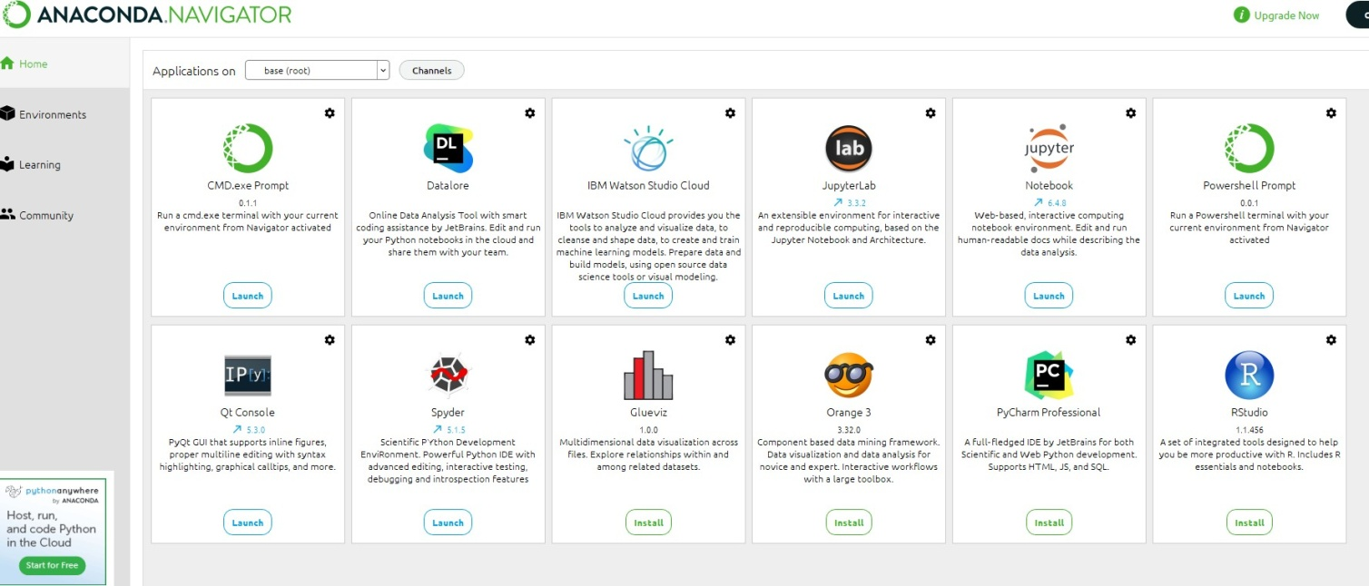
SAMPLE SNAPSHOTS
APPS USED

Slide 9
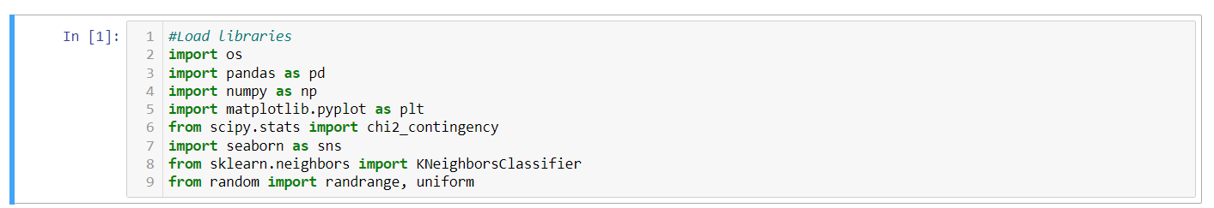
IMPORTING THE LIBRARIES

Slide 10
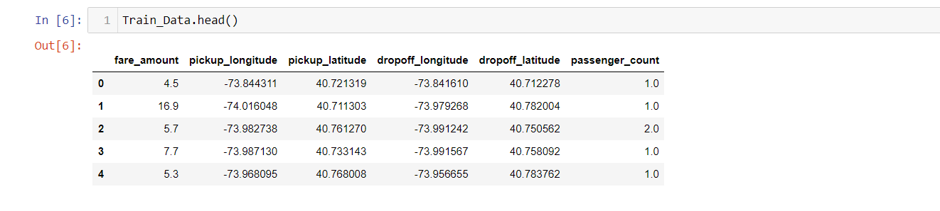
dataset

Slide 11
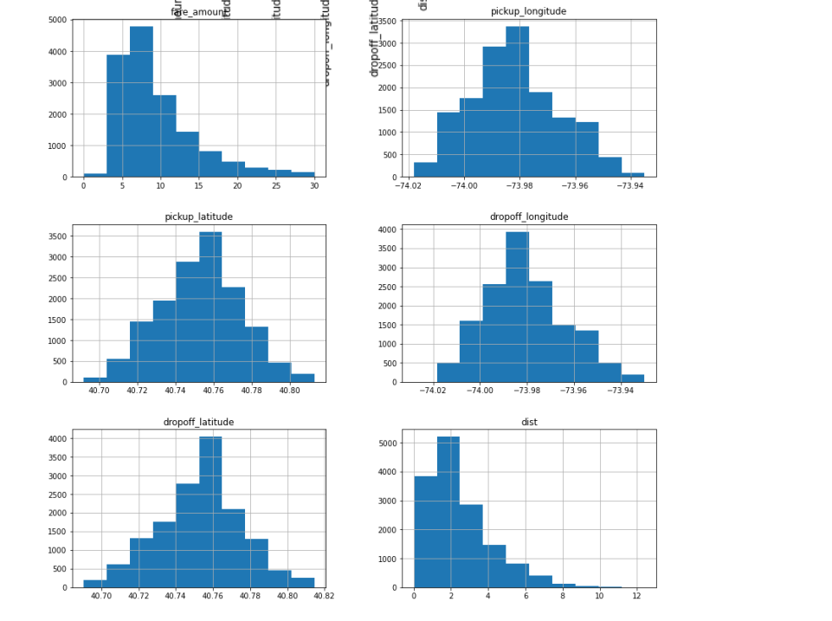
Data Visualisation

Slide 12
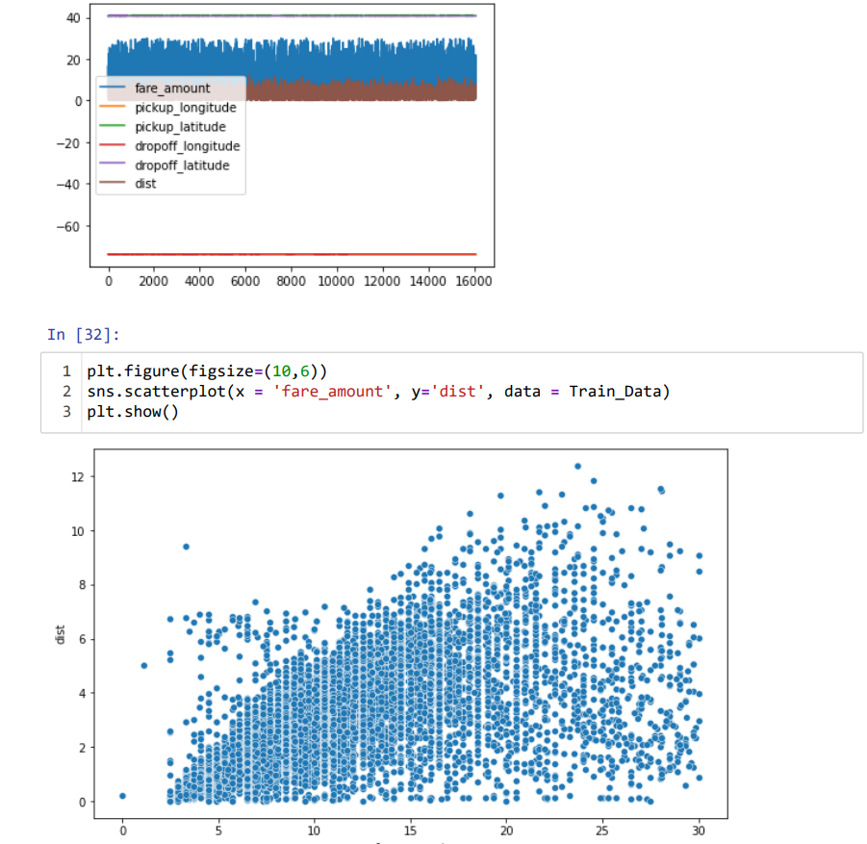
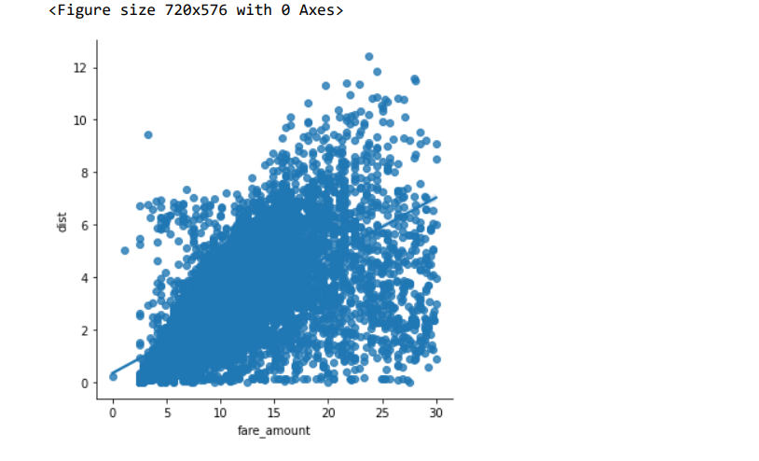

Slide 13
Model Building
In this project, We investigate the usage of different models to predict the output
temperature
Regressor Models
1.Decision Tree
2.Random Forest
3.Linear Regression
4.KNN Imputation

Slide 14
Decision Tree Model
Decision tree builds regression or classification models in the form of a tree structure. It breaks down a dataset into smaller and smaller subsets while at the same time an associated decision tree is incrementally developed. Decision trees can handle both categorical and numerical data.
Error : 28.774663291429192
Accuracy: 71.23

Slide 15
Random Forest
Random Forest Regression is a supervised learning algorithm that uses ensemble learning method for regression. Ensemble learning method is a technique that combines predictions from multiple machine learning algorithms to make a more accurate prediction than a single model
Error : 25.131668346501414
Accuracy : 74.87

Slide 16
Linear Regression
Linear Regression is a supervised machine learning algorithm where the predicted output is continuous and has a constant slope. It's used to predict values within a continuous range
Error : 27.431370940383022
Accuracy : 72.56

Slide 17
KNN Imputation
Implementation of KNN regression is to calculate the average of the numerical target of the K nearest neighbors. Another approach uses an inverse distance weighted average of the K nearest neighbors. KNN regression uses the same distance functions as KNN classification
Error : 34.21410560965663
Accuracy : is 65.80

Slide 18
CONCLUSION
After comparison of the error matrix, the next step we come to is Selection of the most effective model. From the values of Error and accuracy, it is found that all the models perform close to each other. In this case any model can best used for further processes, but Random forest gives better results compared to all other methods. So I will prefer Random Forest Model to be used for further processes. .

Slide 19
REFERENCES
Websites: • www.edwisor.com : Videos from Mentor
https://rpubs.com/ : Coding Doubts
https://stackoverflow.com/questions/51488949/use-haversine-package-to-compare-alldistances-possibilities-of-a-csv-list-of-lo : Haversine Doubt
https://gist.github.com/rochacbruno/2883505 : Calculate Haversine in python Videos Channels
https://www.youtube.com/watch?v=7YfyIhhmwq4 : Distance development in Python
https://www.youtube.com/watch?v=Uct_EbThV1E&list=PLZ7sZ1aAtmIbaEj_PtUqkqdmI1k7libK&index=2&t=690s : Python Coding

Slide 20
THE END

